Slide 1
Total vehicle quality management tv-435 Training on problem Solving Methodologies
TV-435 / Sept 2025

Slide 2
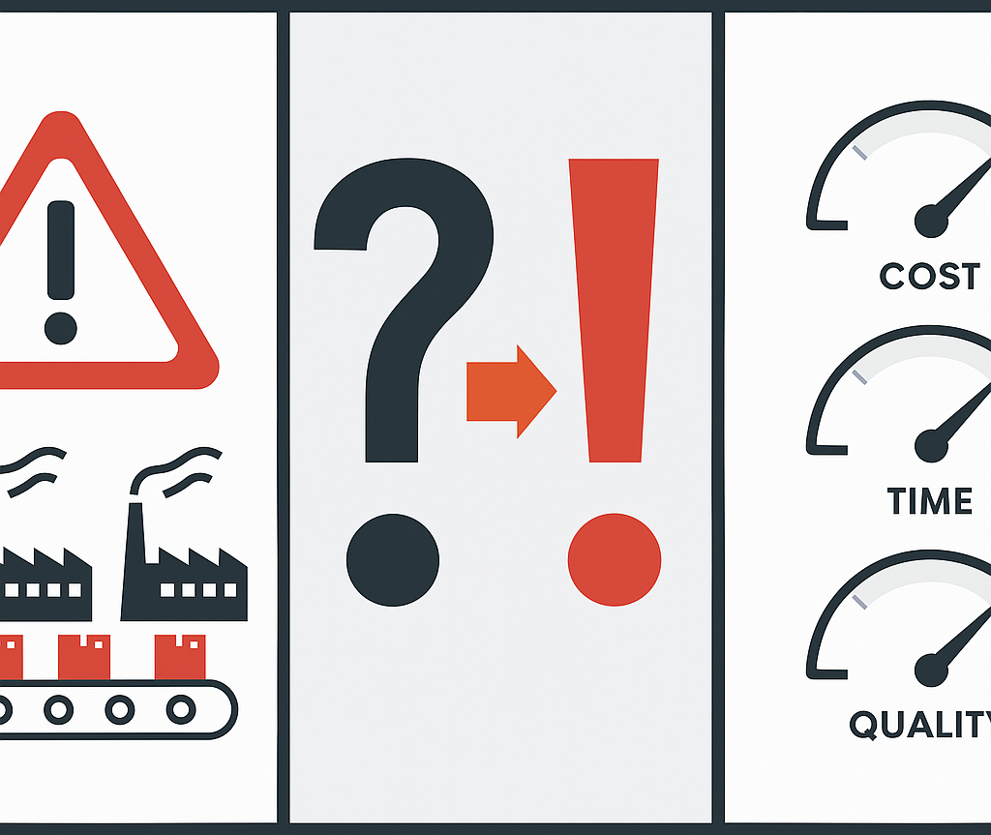
What is a “Problem”?
A problem is a gap or deviation between the current state and the desired state or expected state.
Defining a Problem involves clearly identifying a
Scope
Root Causes
Factors affecting & affected due to the issue
Impact of the issue
Identifying a Problem is to
Closely observe the processes
Collect relevant data
Analyze the data to detect any deviations from the expected norms or standards.

Slide 3
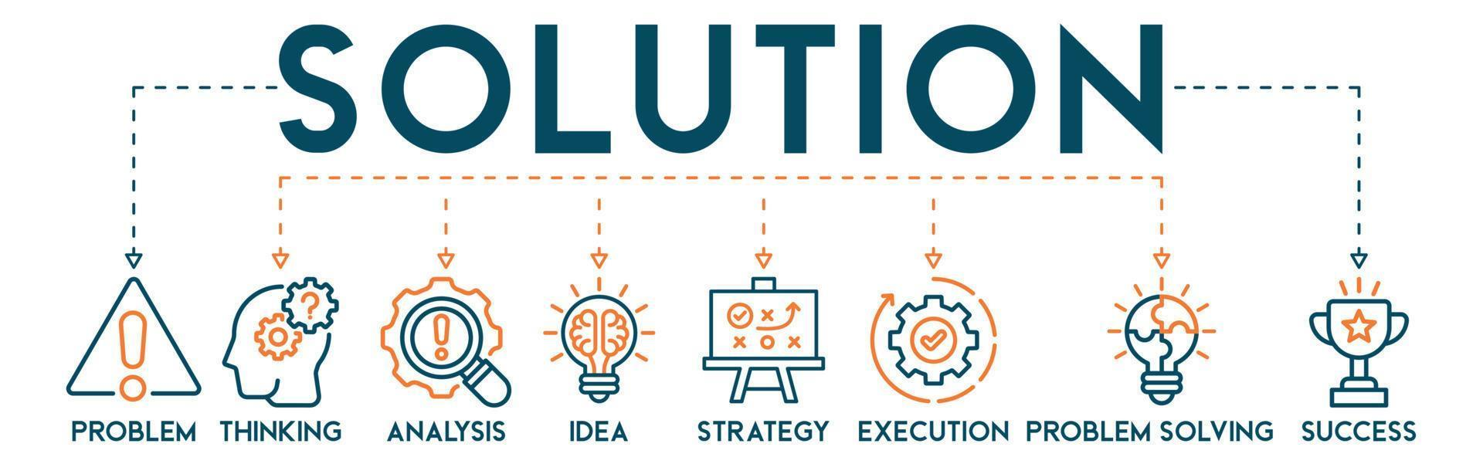
Introduction to Problem Solving
What is a “Solution” ?
A solution is a validated action plan that permanently eliminates the root cause of a problem.
Effective solutions are specific, measurable, implementable within constraints, and prevent recurrence rather than just treating symptoms.

Slide 4
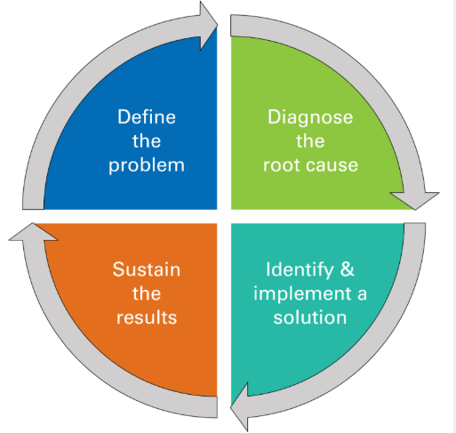
“Problem Solving”
A systematic, data-driven process for identifying, analyzing, and resolving issues to close the gap between current and desired performance.
This is done to employ structured methodologies, ensuring long-term, sustainable improvements that support operational and strategic goals.

Slide 5
Problem Solving Framework
Problem Solving
Immediate Containment Action (ICA)
Corrective Action
Preventive Action
Fix current issue and restore normal operations.
Eliminate recurrence possibilities through system changes.
Quick containment actions to prevent further damage.

Slide 6
Problem Solving Methodologies
Problem Mgt. Tools
1
Classic QC Tools
2
New QC Tools
3
BMW Specific Methodologies
4

Slide 7
MODELS OF PROBLEM SOLVING
There are many quality tools that can be applied to solving a problem, with steps and procedures specific to the technique. Some approaches are geared more toward identifying true root causes than others, some are more general problem-solving techniques, and others offer support for sustaining successful change.
Five Whys (5W)
Fishbone diagram
Eight disciplines (8D) model
Pareto chart
DMAIC

Slide 8
5 WHY ANALYSIS
WHY
5 Why Analysis drills through symptom layers by repeatedly asking "Why?" to uncover root causes.
WHY
WHY
Use Case: Used for simple to moderate problems where root cause lies within 5 levels of questioning depth.
ROOT CAUSE
WHY
WHY
This simple yet powerful technique prevents superficial problem-solving by forcing deeper investigation beyond obvious symptoms.

Slide 9
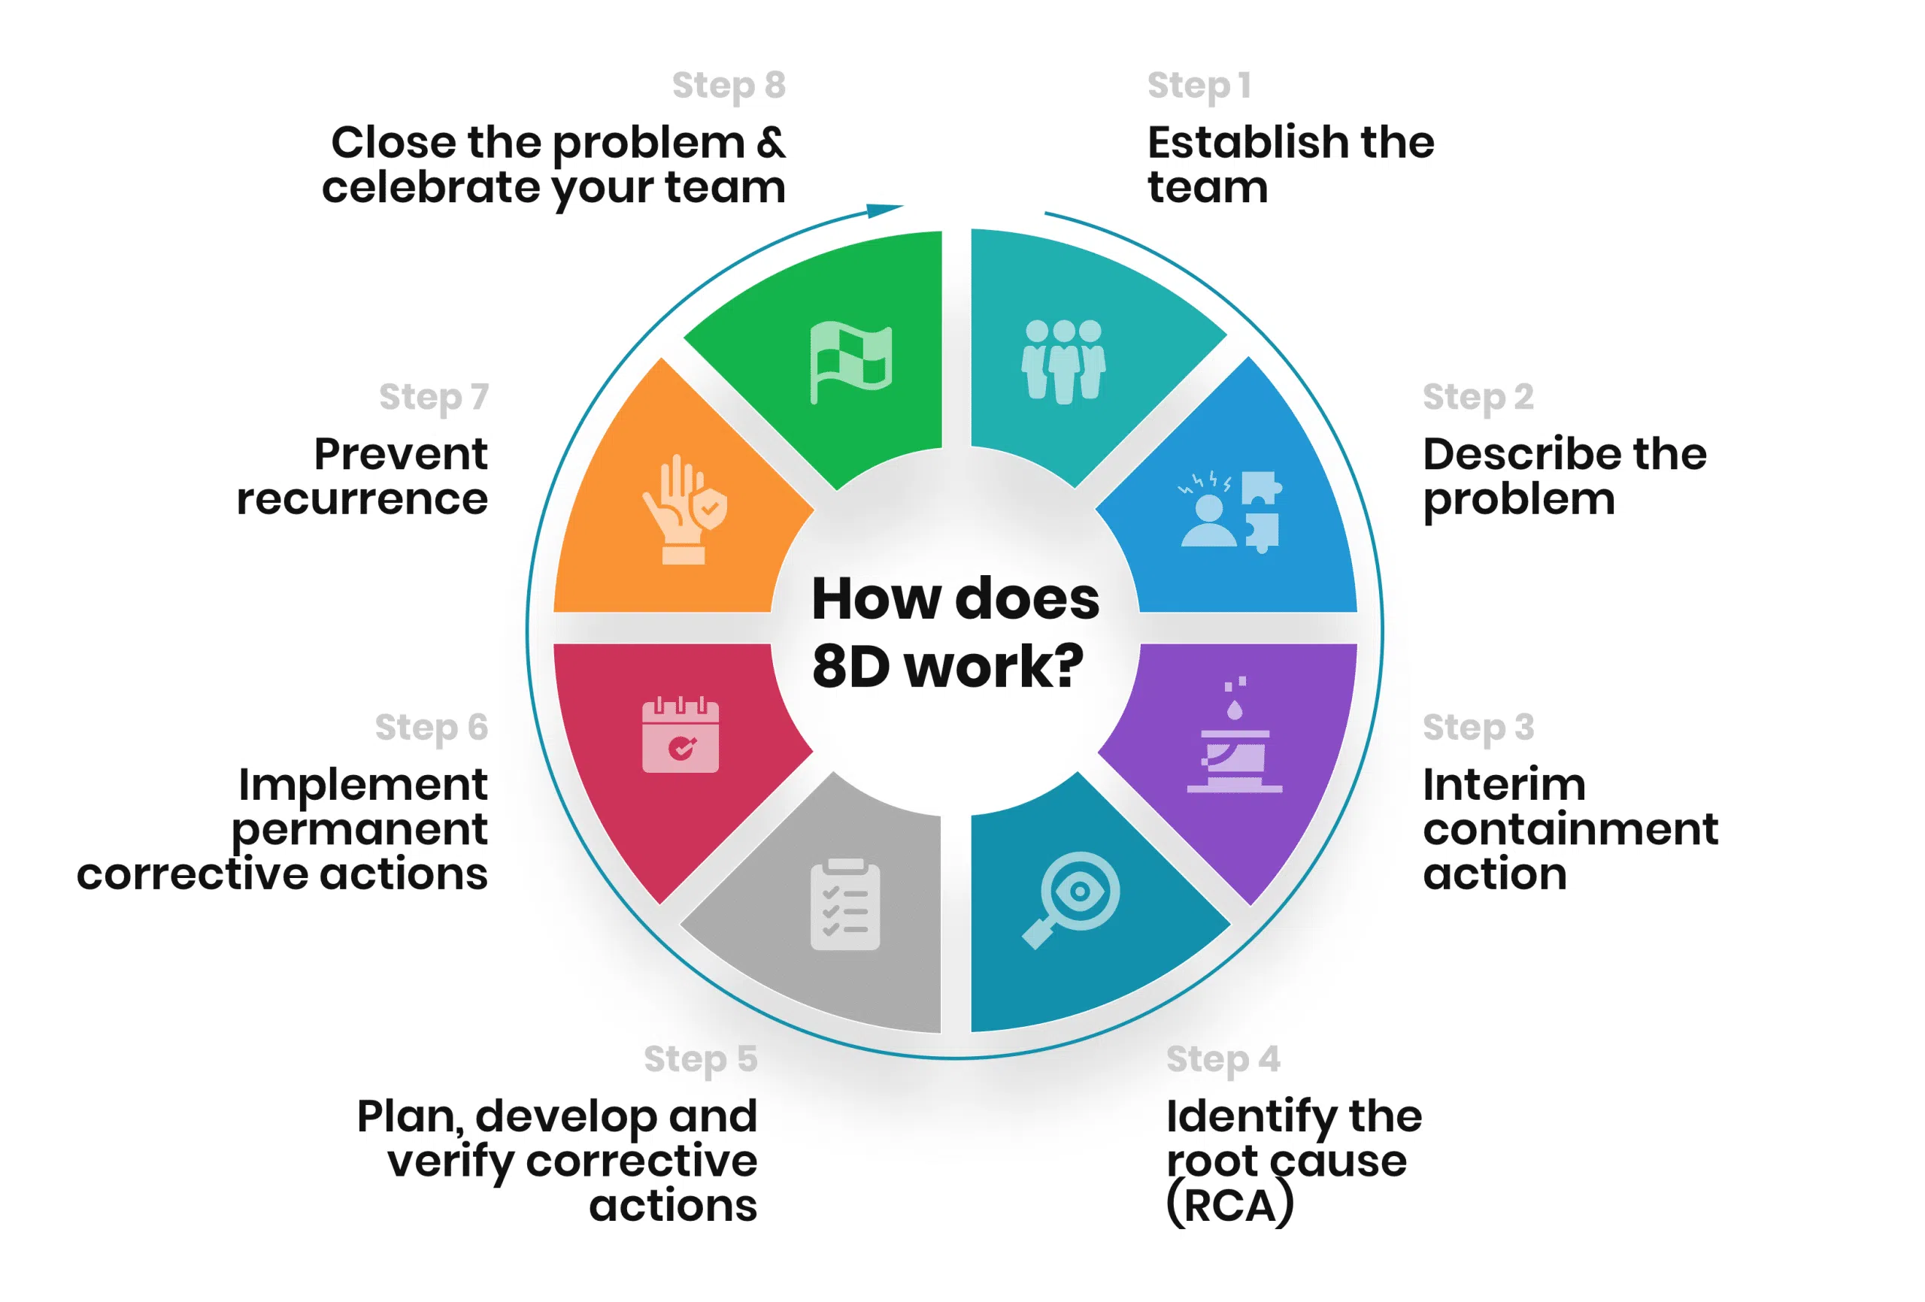
8 DISCIPLINES (8d) METHODLOGIES
Use Case: Applied when customer complaints require formal response with documented problem resolution and preventive measures.
Example: Supplier receives complaint about defective brake components; uses 8D to systematically resolve and document corrective actions.
8D provides structured problem-solving framework requiring cross-functional teams to systematically identify, correct, and prevent quality problems.
Each discipline builds on previous steps, ensuring comprehensive resolution with documented evidence for customer assurance.

Slide 10
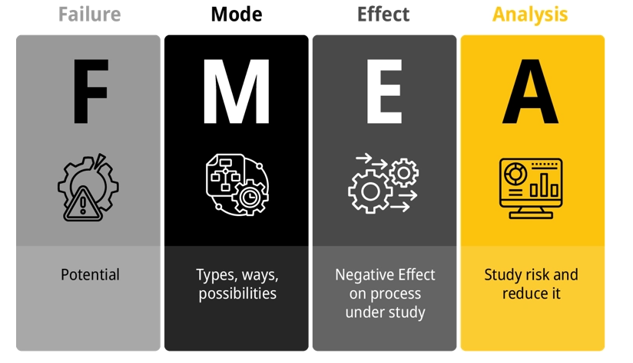
FAILURE MODE AND EFFECT ANALYSIS (fmea)
FMEA proactively identifies potential failure points, their effects, and criticality through Risk Priority Numbers (RPN).
By analysing severity, occurrence, and detection ratings, teams prioritize prevention efforts on highest-risk failures before they occur.
Use Case: Deployed during product/process design to identify potential failures before production launch.
Example: New assembly line design undergoes FMEA to identify where conveyor system might fail and impact production.

Slide 11
PDCA CYCLE
Use Case: Continuous improvement projects requiring iterative testing and refinement before full implementation.
Example: Testing new quality inspection procedure in one production cell before plant-wide rollout.
PDCA (Plan-Do-Check-Act) creates systematic improvement through controlled experimentation.
Small-scale pilots validate solutions before full deployment, reducing implementation risk while building organizational learning.
PLAN
DO
ACT
CHECK

Slide 12
CAUSE ANALYSIS TOOLS
Cause analysis tools are helpful tools for conducting a root cause analysis for a problem or situation. They include:
Fishbone diagram: Identifies many possible causes for an effect or problem and sorts ideas into useful categories.
Pareto chart: Shows on a bar graph which factors are more significant.
Scatter diagram: Graphs pairs of numerical data, with one variable on each axis, to help you look for a relationship.
Notes:
12

Slide 13
ROOT Cause Analysis
Use Case: Complex failures requiring multiple investigation techniques to identify true underlying causes.
Example: Product recall investigation combining data analysis, interviews, and testing to find contamination source.
RCA employs multiple investigative tools to systematically identify true problem origins.
By combining data analysis, process mapping, and cause verification, RCA ensures solutions address fundamental issues rather than symptoms.
PROBLEM
DEFINE
ASSEMBLE
LOCATE
FIND
CREATE
MONITOR
SOLUTION
Notes:
13

Slide 14
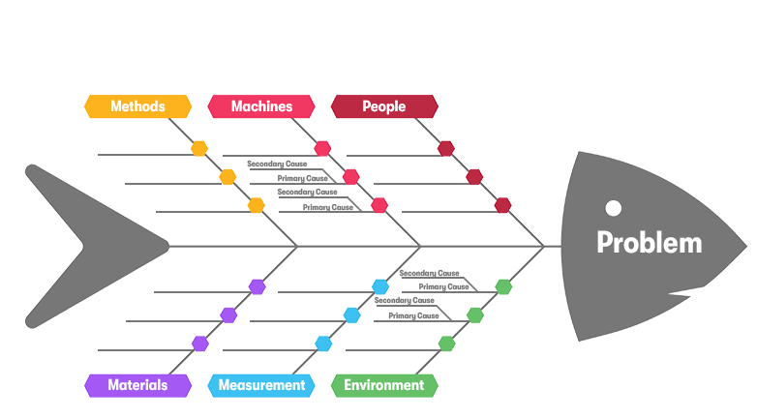
cause and effect diagrams
It is also called as fishbone diagram or Ishikawa diagram.
It identifies many possible causes for an effect or a problem.
The main purpose is to understand the root cause behind the problem statement.
Use Case:
When figuring out the possible causes for a problem.
When a team’s thinking tends to fall.

Slide 15
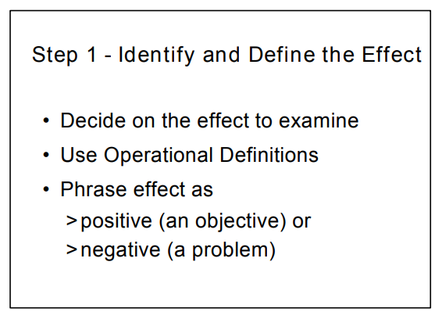
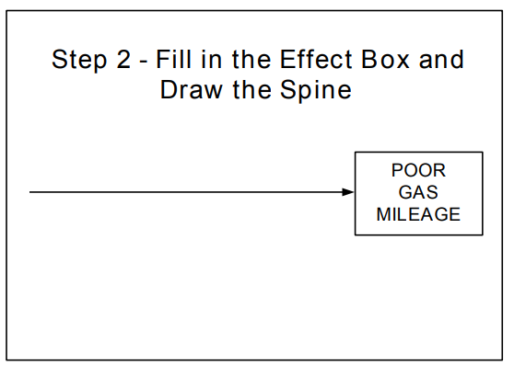
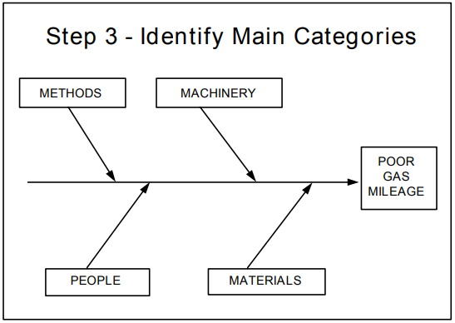
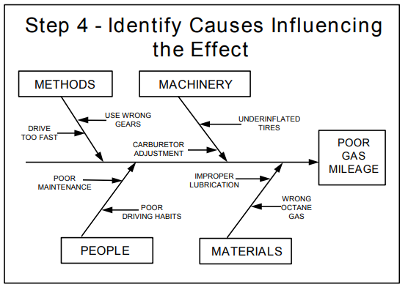
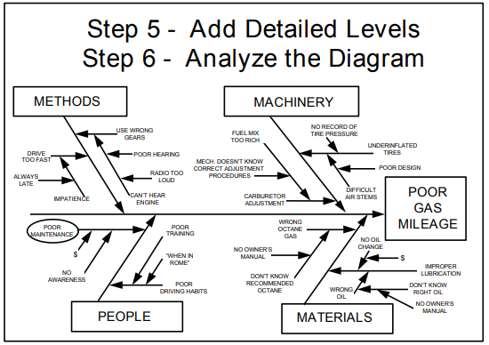
cause and effect diagrams(Contd….)
Steps to create:
Step 1 - Identify and Define the Effect or problem.
Step 2 - Fill in the Effect Box and Draw the Spine.
Step 3 - Identify Main Categories & sub categories.
Step 4 - Identify Causes Influencing the Effect.
Step 5 - Add Detailed Levels & Analyze the Diagram
Advantages:
It helps you locate bottlenecks in the process.
It helps you find ways to improve the process.
It involves an in-depth discussion of the problem, which educates the team.
It prioritizes further analysis and helps you take corrective action.

Slide 16
pareto diagrams
A Pareto Chart is a visual tool used to highlight the most significant factors in a dataset.
Steps to create a pareto diagram :
Step 1 : Identify and Define the Effect or problem.
Step 2 : Fill in the Effect Box and Draw the Spine.
Step 3 : Identify Main Categories & sub categories.
Step 4 : Identify Causes Influencing the Effect.
Step 5 : Add Detailed Levels & Analyze the Diagram.
Advantages:
It enhances organizational efficiency.
It helps to determine the most significant causes of a problem.
It enhances problem-solving skills.
It improves decision making within the organization.

Slide 17
pareto diagrams(Contd….)

Slide 18
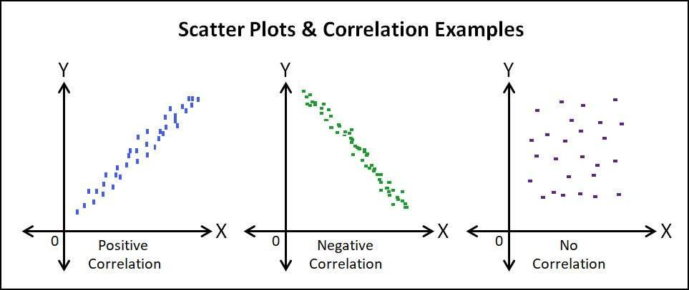
scatter diagrams
WHAT?
A scatter diagram is a type of data visualization that shows the relationship between different variables and the data is shown by placing various data points between an x- and y-axis.
A scatter plot uses dots to represent values for two different numeric variables.
Identification of correlational relationships are common with scatter plots.
WHEN?
When you have paired numerical data.
When trying to determine whether the two variables are related.
When determining whether two effects that appear to be related both occur because of the same cause.

Slide 19
Scatter diagram (contd..)
Steps to Create a Scatter Diagram :
Step 1 - Identify the two variables which you want to investigate.
Step 2 - Collect the data and ensure that all other potential variables remain constant.
Step 3 - Start to record data for both set of variables.
Step 4 - If the variables normally operate over a range, try to collect data over as much of the range as possible.
Step 5 -As you collect data, start to plot on a graph and review it to check the relationship.
Advantages:
It shows the relationship between two variables.
It is the best method to show you a non-linear pattern.
Observation and reading are straightforward.

Slide 20
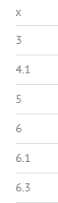
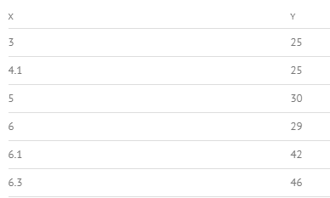
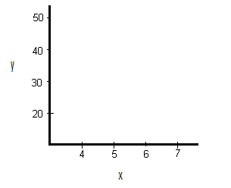
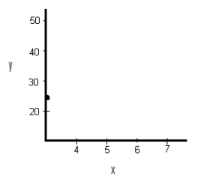
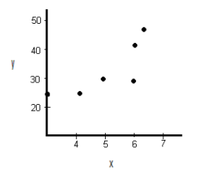
Scatter diagram (contd..)
Step1-Tabulate the given data
Step2-Draw the axes with given data and a specified scale
Step3-Start plotting the graph
Step4-Draw the remaining data and analyze their relationship

Slide 21
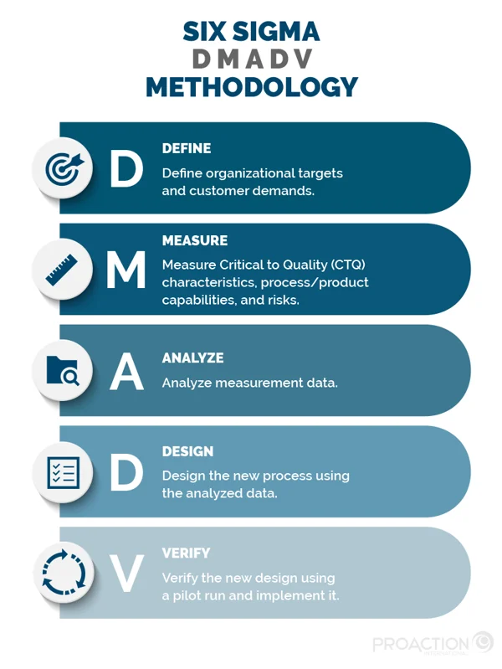
Six-sigma (dmadv) METHODOLOGY
DMADV methodology ensures new products/processes achieve Six Sigma capability from launch.
Through rigorous customer requirement analysis and design optimization, DMADV prevents defects rather than fixing them post-production.
Use Case: Designing new products/processes to meet Six Sigma quality levels from inception.
Example: Developing new pharmaceutical packaging line designed to achieve more than 3.4 defects per million from day one.

Slide 22

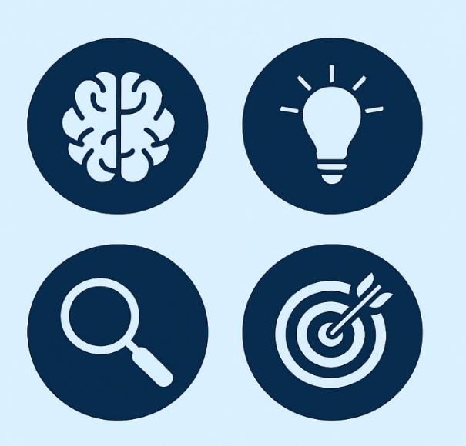
Preventive measures
YOKE
POKA
MISTAKE PROOFING (POKA-YOKE)
Use Case: Designing processes/products that make errors impossible or immediately detectable.
Poka-Yoke eliminates defects by making errors physically impossible or immediately visible.
Through clever design of fixtures, sensors, and guides, processes become self-correcting, achieving zero-defect production without relying on human vigilance.
KAIZEN
Use Case: Engaging all employees in identifying and implementing small, incremental improvements daily.
Kaizen philosophy empowers every employee to contribute continuous small improvements.
These incremental changes compound into transformational results, creating culture where excellence becomes daily habit rather than periodic initiative.
BRAINSTORMING
Use Case: Generating creative solutions when traditional approaches fail or innovative breakthroughs needed.
Structured brainstorming unleashes collective creativity by suspending judgment and encouraging wild ideas.
Through divergent thinking followed by convergent evaluation, teams discover innovative solutions hiding beyond conventional thinking.

Slide 23

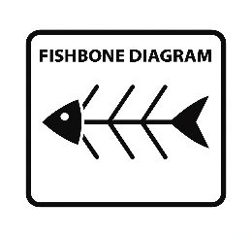
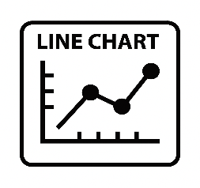

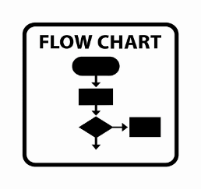
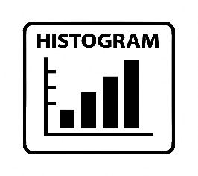
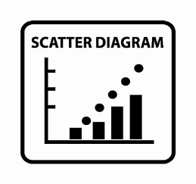
7 qc tools
A Check Sheet is a structured tool used to collect and tally data in real time.
A Fishbone Diagram is a visual tool used to identify root causes of a specific problem.
A Line Chart is a visual tool used to display trends or changes over time.
A Pareto Chart is a visual tool used to highlight the most significant factors in a dataset.
A Flow Chart is a visual tool used to map out the steps of a process or system.
A Histogram is a graphical tool used to display the frequency distribution of data.
A Scatter Diagram is a visual tool used to show the relationship between two variables.

Slide 24
New QC Tools Tool no. 1
AFFINITY DIAGRAM
Fault Tree Analysis
Histograms

Slide 25
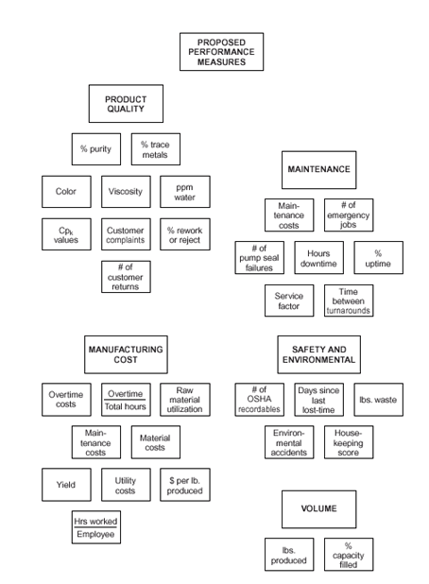
AFFINITY DIAGRAM
Use Case: Organizing large amounts of qualitative data into natural groupings for pattern recognition. For example, grouping 200+ customer feedback comments into themed categories revealing primary satisfaction drivers.
Affinity diagrams transform chaos into clarity by organizing brainstormed ideas into natural groups. This visual clustering reveals patterns and priorities hidden in overwhelming detail, enabling focused action planning.

Slide 26
NEW qC tools Tool no. 2
Affinity Diagram
FAULT TREE ANALYSIS
Matrix Diagram

Slide 27
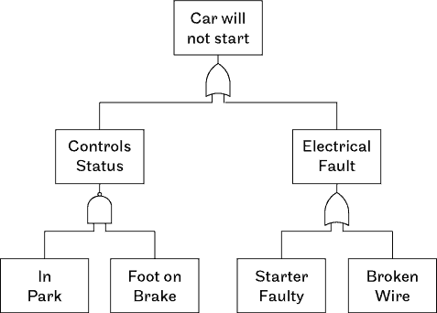
FAULT TREE ANALYSIS (fta)
Use Case: Analysing complex system failures through logical breakdown of contributing factors. For example, Tracing production line stoppage through AND/OR gates to identify all possible failure combinations.
Fault Tree Analysis maps failure logic through Boolean relationships between contributing events. By calculating path probabilities, teams identify critical failure modes and optimal prevention points for maximum system reliability.

Slide 28
NEW qC tools Tool no. 3
Affinity Diagram
Fault Tree Analysis
MATRIX DIAGRAM

Slide 29
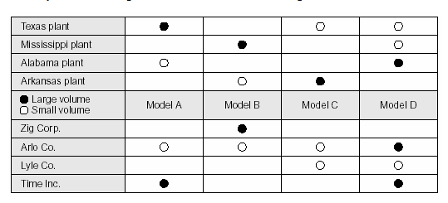
MATRIX DIAGRAM
Use Case: Analyzing relationships between multiple sets of factors for decision optimization. For example, comparing customer requirements against product features to identify development priorities.
Matrix diagrams systematically evaluate multi-dimensional relationships for optimal decision-making. By visualizing interaction strengths between factors, teams identify high-impact opportunities and avoid conflicting actions.

Slide 30
MATRIX DIAGRAM(contd..)
Types of MATRIX DIAGRAM :
An L-shaped matrix relates two groups of items to each other (or one group to itself).
A T-shaped matrix relates three groups of items: groups B and C are each related to A; groups B and C are not related to each other.
A Y-shaped matrix relates three groups of items: each group is related to the other two in a circular fashion.
A C-shaped matrix relates three groups of items all together simultaneously, in 3D.
An X-shaped matrix relates four groups of items: each group is related to two others in a circular fashion.
A roof-shaped matrix relates one group of items to itself; it is usually used along with an L- or T-shaped matrix.

Slide 31
Classic And New QC tools use in process identification & analysis
Identification
Analysis
Histogram
Flow chart
Pareto Diagram
Control chart
Cause and Effects diagram
Check sheet
Scatter plot

